Slide 1
Data Analytics for EU Law
What is the proximity of political parties in the European Parliment ?
HEC Paris
European Business Law and Global Affairs
Année 2023 - 2024
Lucie Moutard
Julien Vacherot
Anatole de Rauglaudre

Slide 2
Our questions
Question: What is the proximity of political parties in the European Parliment ?
Can we identify correlations among the politicial parties by analysing historical votes in plenary sessions?
Can we predict a party’s vote using a prediction model?
Method: scrapping the European Parliment Roll Call Votes and make a prediction model
Scrapping the European Parliament roll call votes from the European Parliament website, loading them in an object
Sanitize and optimize dataframe obtained (i.e. anomalies and missing values, dimension)
Analyse dataframe by identifying correlations between variables
Select and apply a model that predicts target party votes using independent variables
Gather and analyse results
1

Slide 3

Scrapping the European Parliament results of roll-call votes
Structure of the results of roll-call votes page for each plenary
Results of roll-call votes section of Minutes of a particular plenary session
Title of the vote during the plenary
Members of each party who voted for
Members of each party who voted against
2

Slide 4
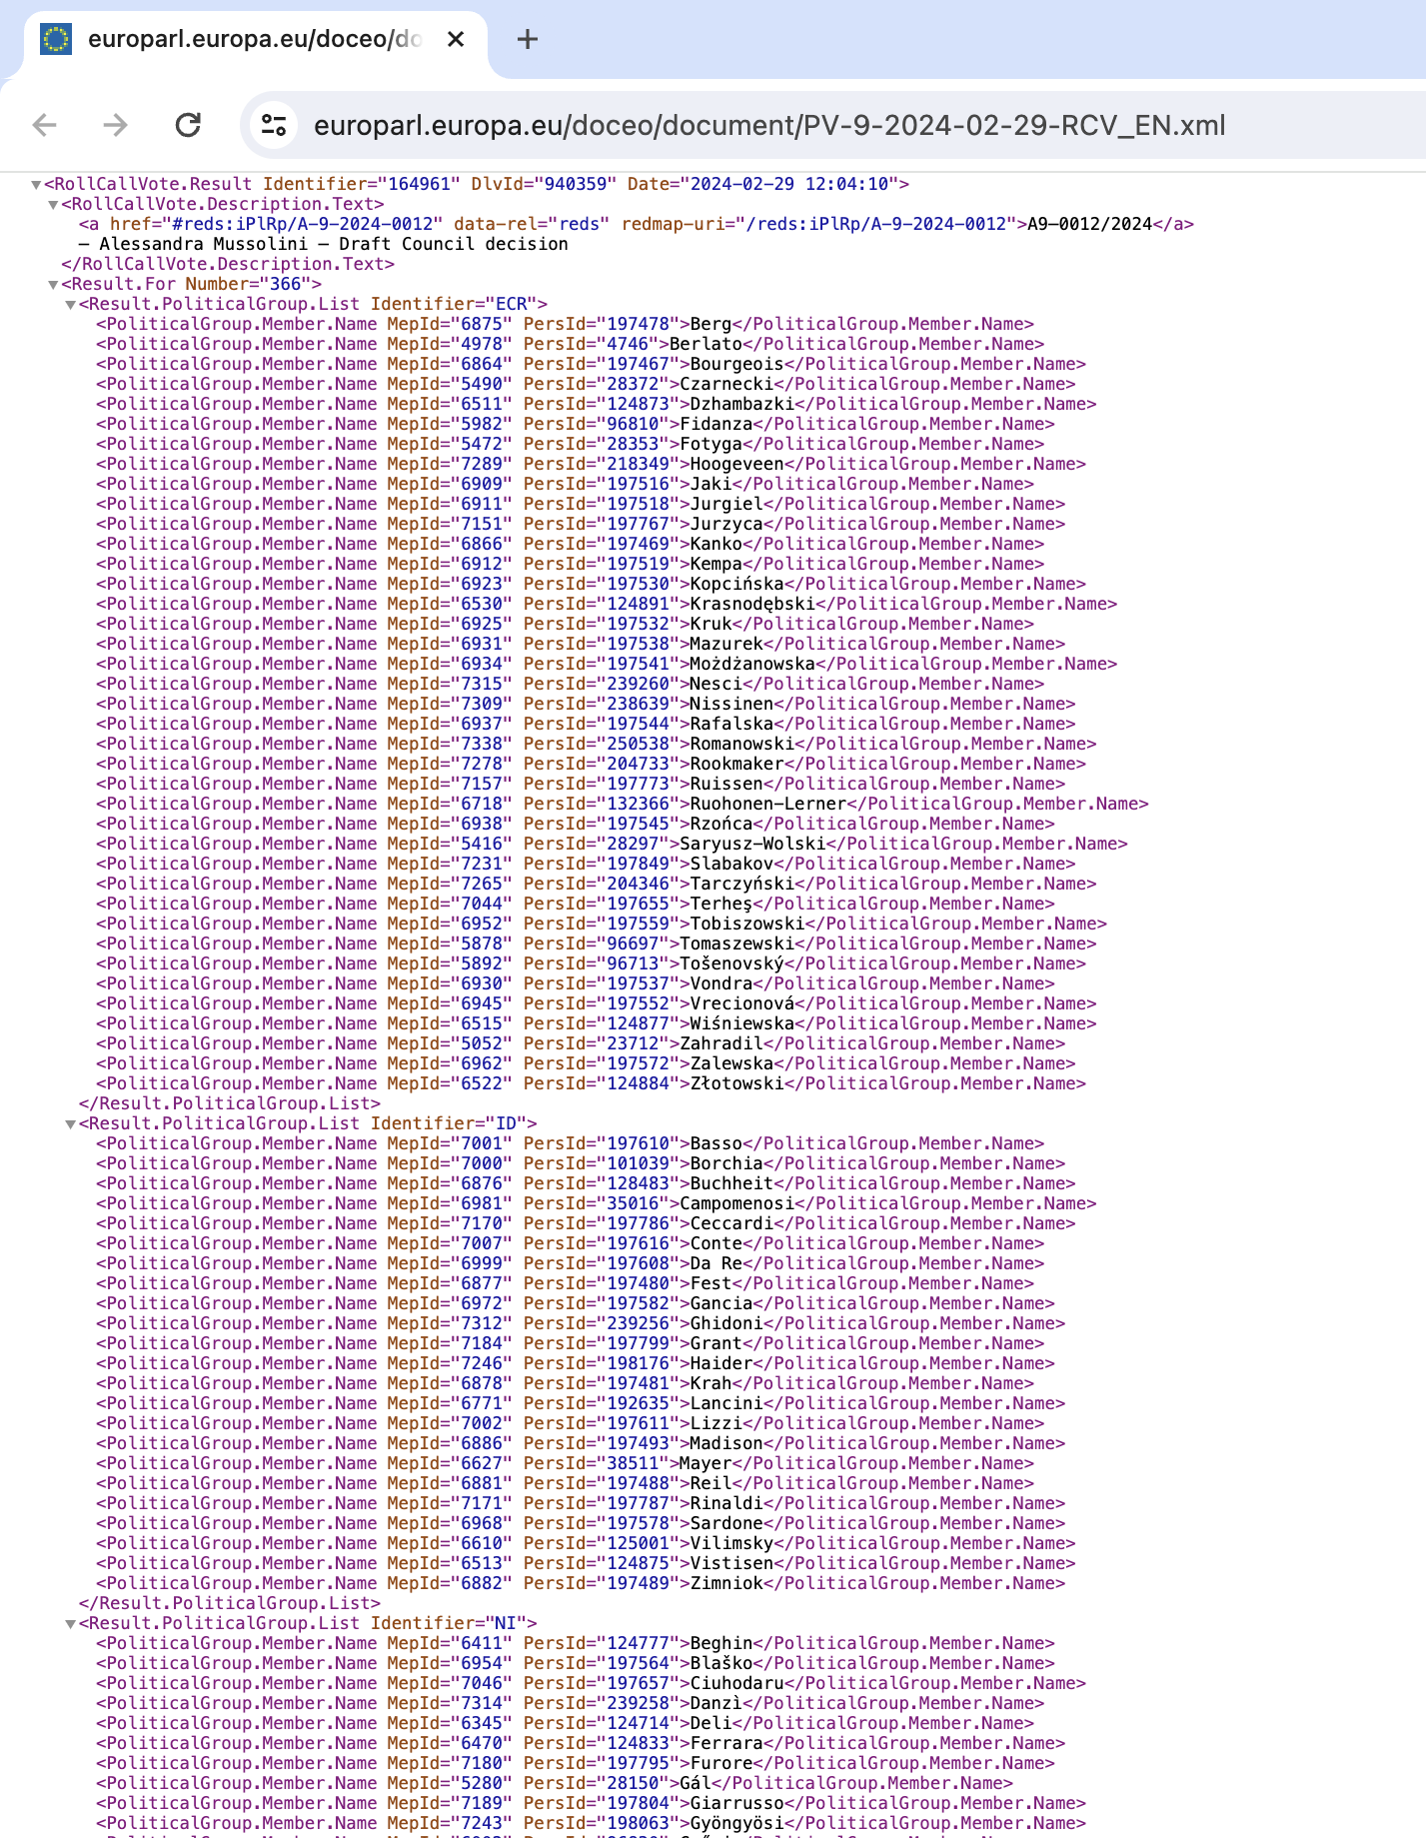
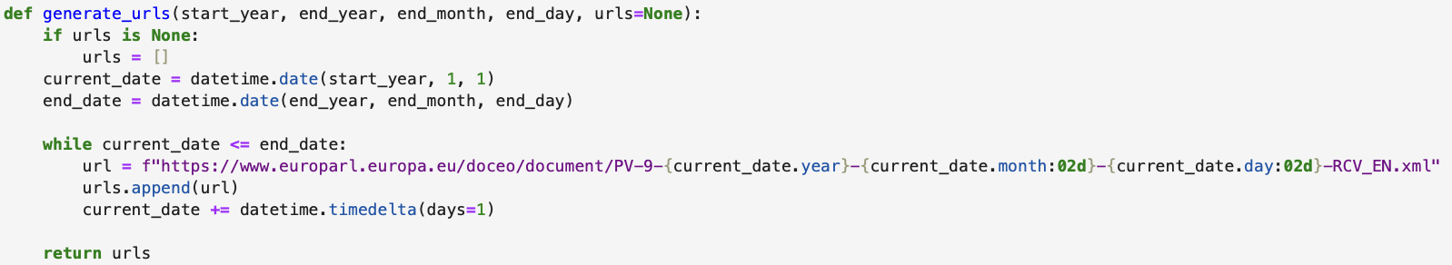
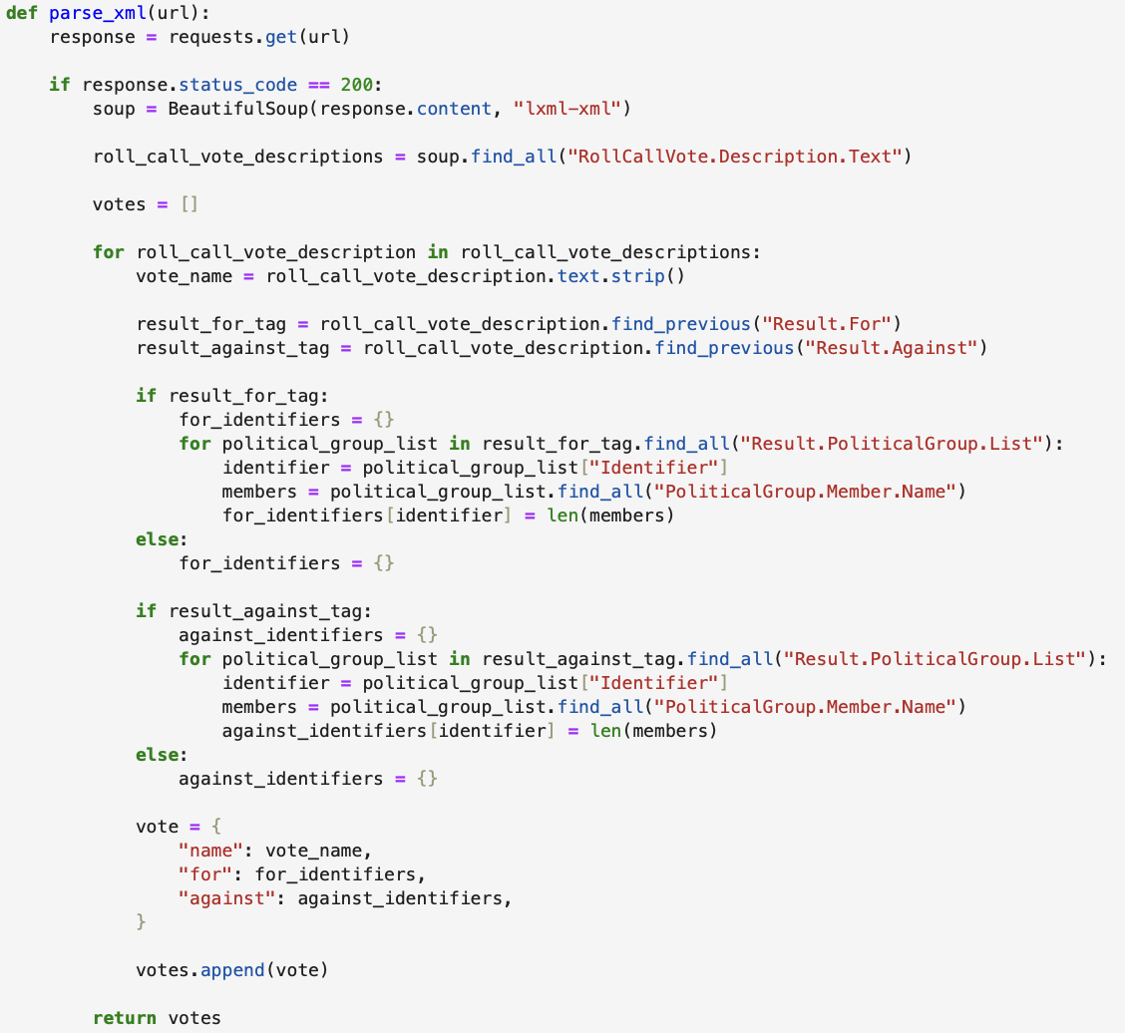
Scrapping the European Parliament results of roll-call votes
Using xml page
url structure
1
Create a function to generate the urls
vote description
2
1
Create a function to parse the target data
3
Members that voted for (against) for each party
2
3
3
3
3
3

Slide 5
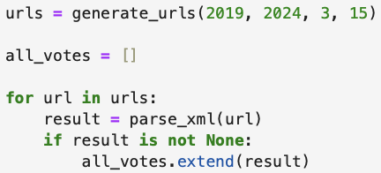
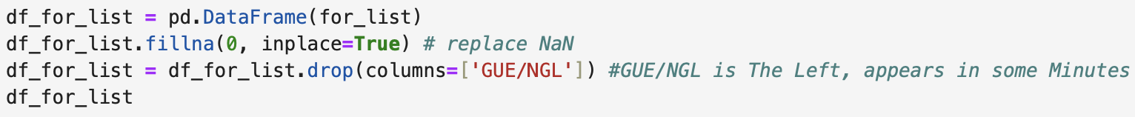
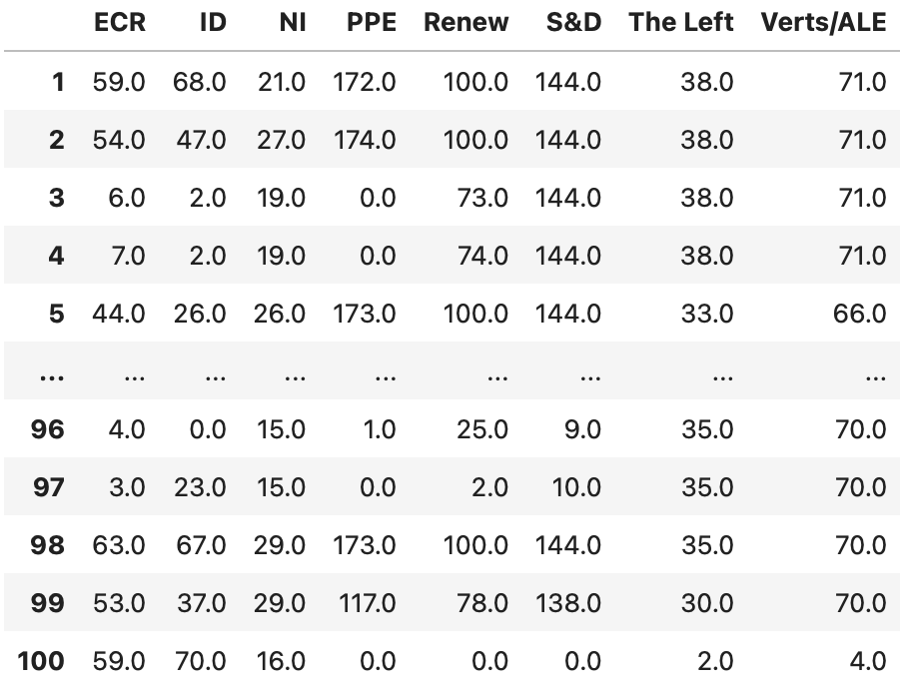
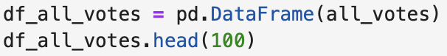
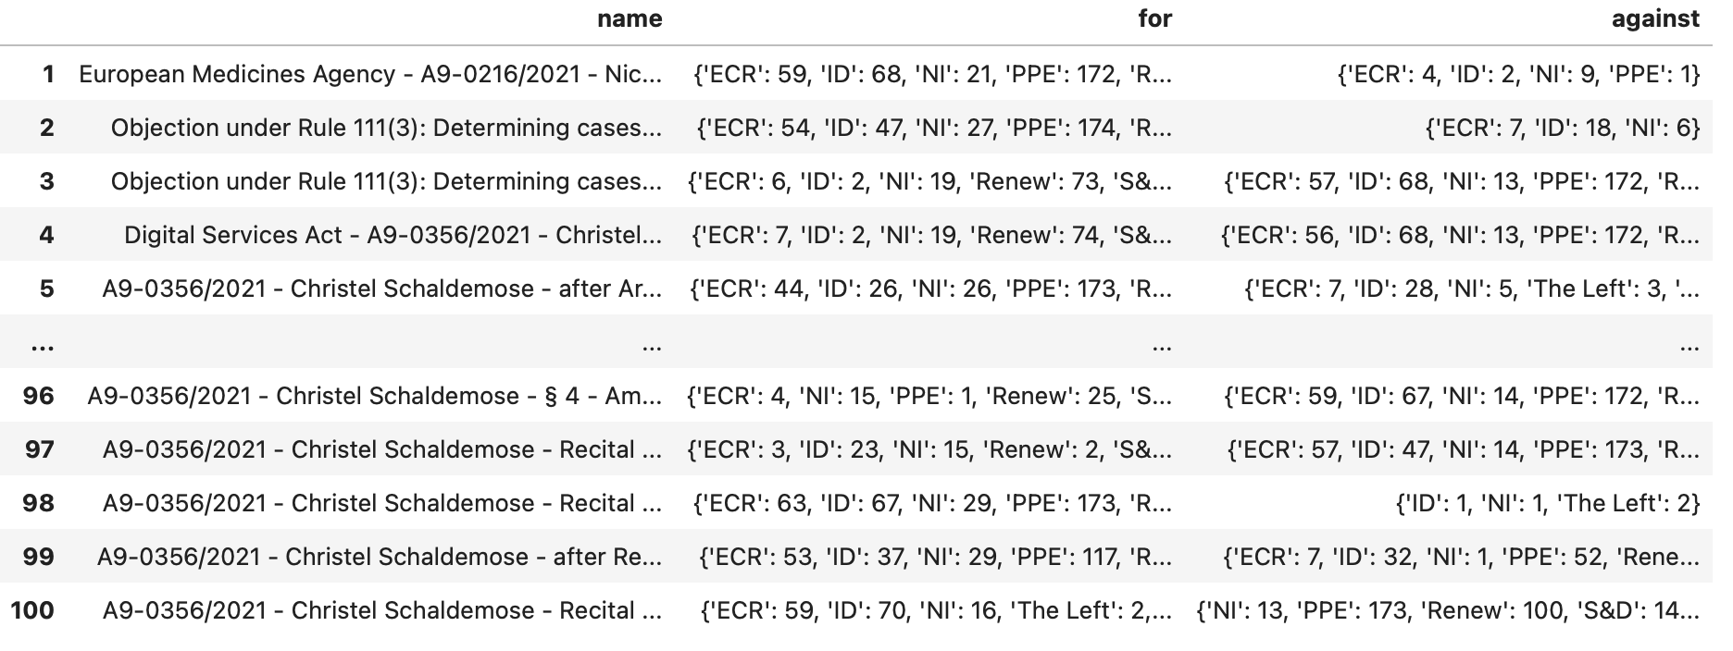
Preparing and cleaning the data
Using xml page
Generating the object and converting to DataFrame
Creating and cleaning a DF with only votes for
Next? Dividing by number of members for each party to have percentage
Some values are above the number of members in party, deleting those values
4

Slide 6
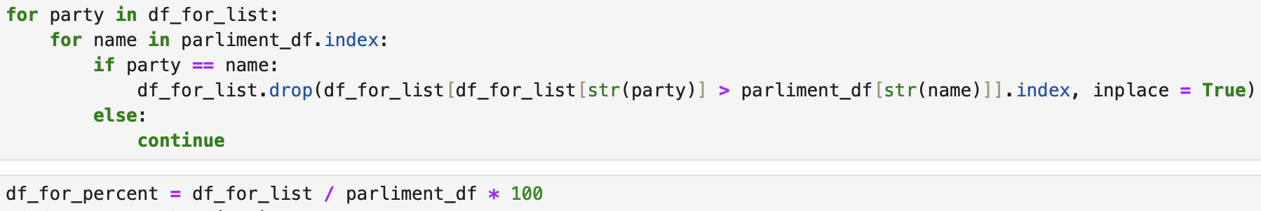
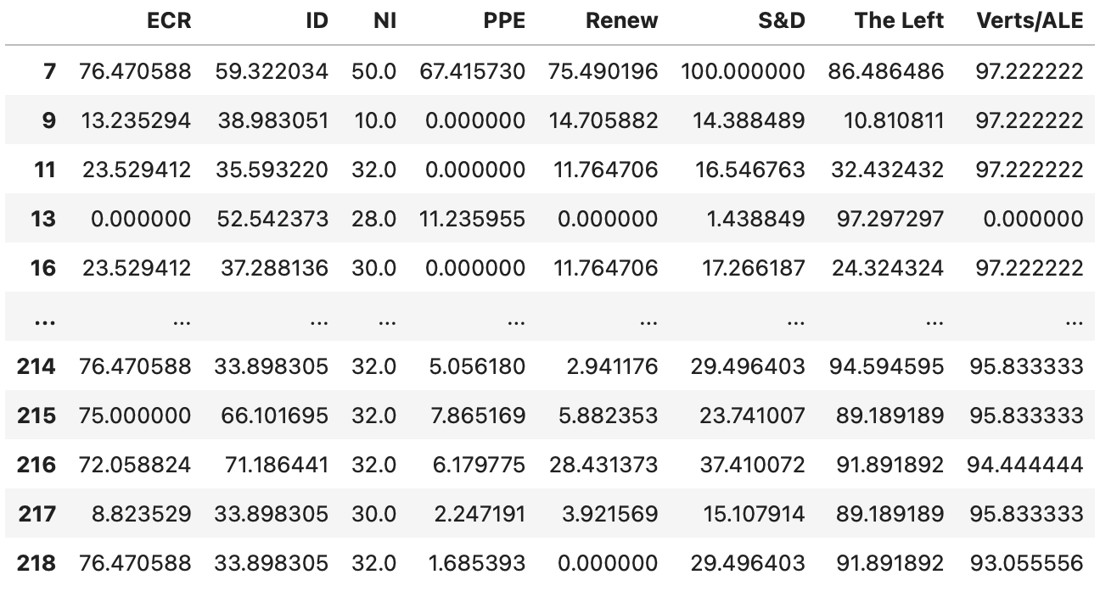
Preparing and cleaning the data
Using xml page
Making the dataframe percent
5

Slide 7
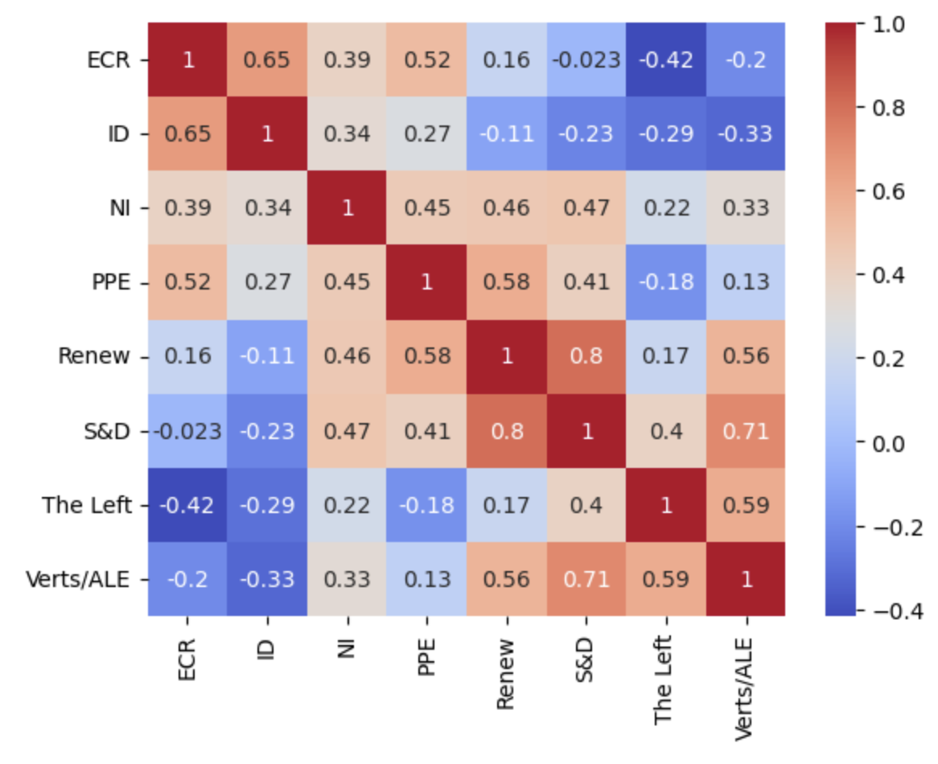
A first approach : the correlation coefficient
Results that seems relevant with the current political dispositions of the European Parliament
A strong opposition with the two extreme-wing-parties
High correlation between left-wing and right wing parties
The strongest correlation seems to be between Renew and S&D
6

Slide 8
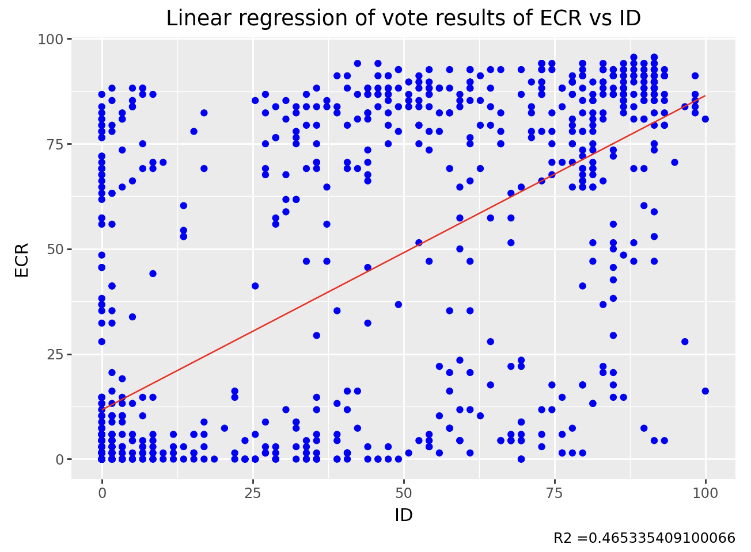
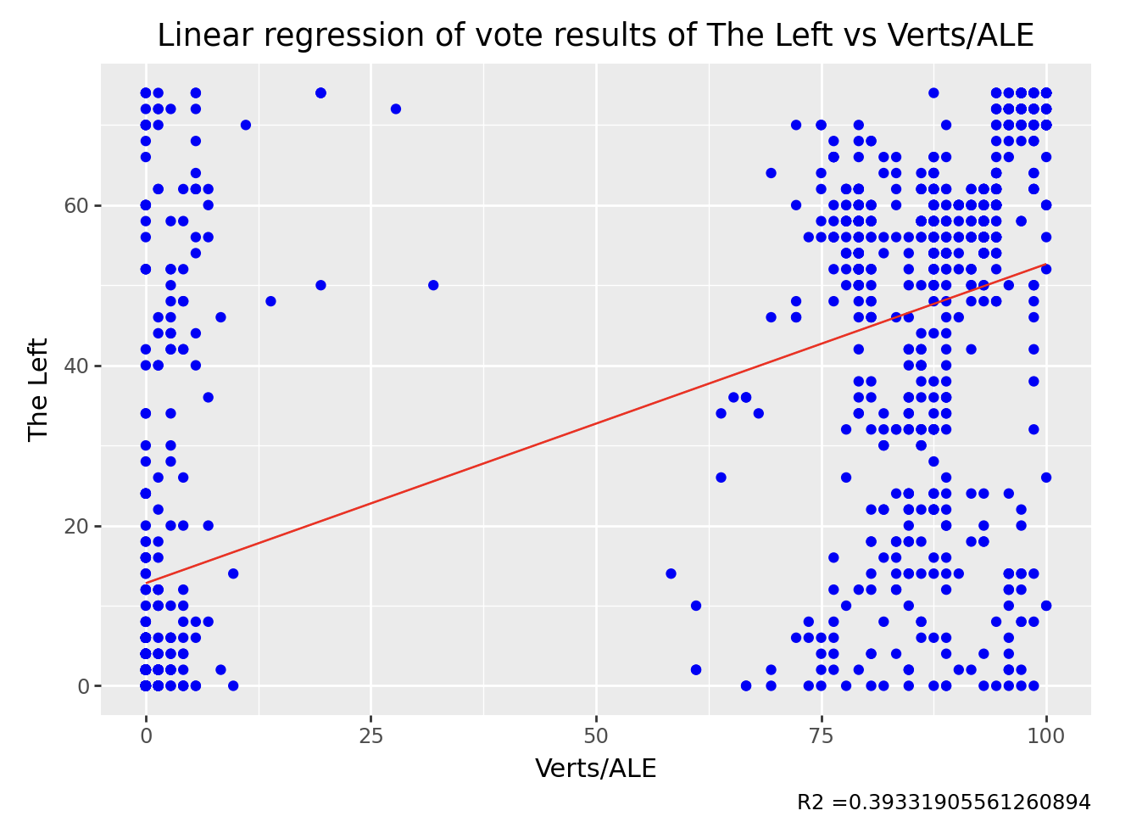
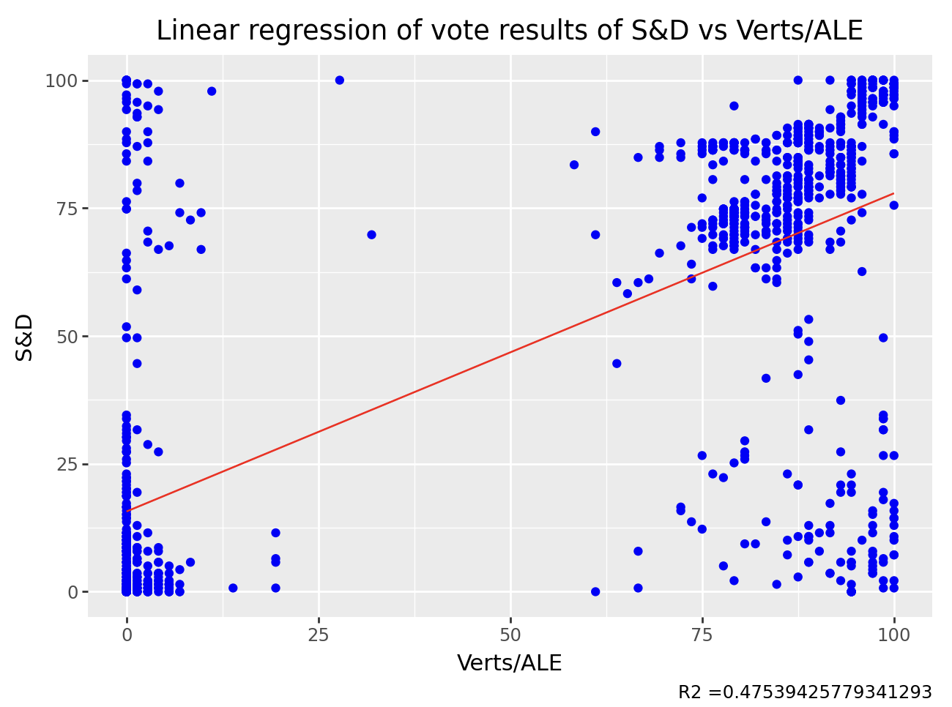
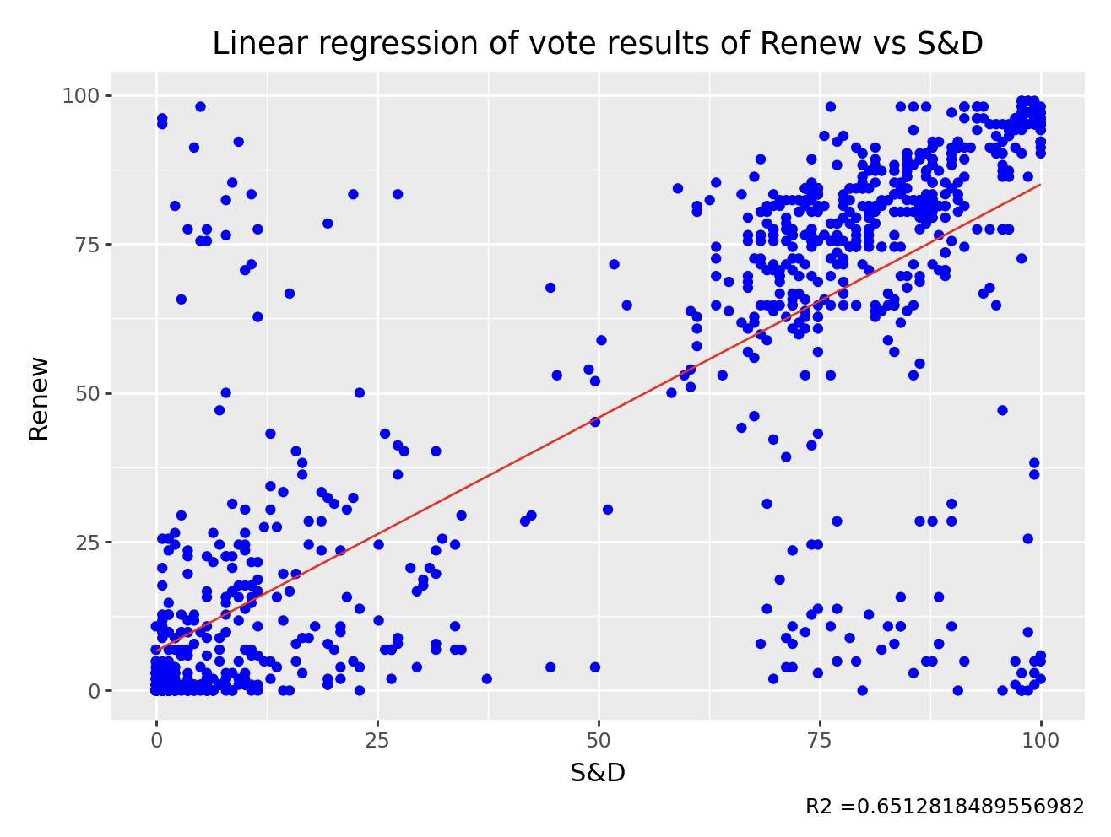
A second look : the simple linear regressions
7

Slide 9
Lesson 1 : No clear link between the vote of most parties seems decorrelated
We realized linear regressions between all the different groups in the European Parliament
Unless for two political groups, we find no clear evidence of links between the votes of the different MPs.
This results seems logical between parties which are not from the same side of the Parliament, but looks different from national parliaments, where parties with similar ideological basis usually vote often together
8

Slide 10
Lesson 2 : Even political groups with the same ideological basis seems not correlated
Even political groups with strong similarities are not correlated with their votes
The main example of this situation is the absence of evidence of links between ECR and ID.
Indeed, they represent two extreme-right-wing political groups, but cannot match on many points.
However, it has to be admitted that similarities exist on several votes.
9

Slide 11
Lesson 3 : One existing correlation : S&D and Renew
A proximity in the speeches proved by our study (R²>60% in the political field is an efficient proof of correlation)
Concerning the votes where the political view of the two groups are clearly defined (more than 75% of vote for or against the text), clear proximity.
This can looks quite strange from France, but is more logical in the EU, because of the central position of this two groups in the political landscape.
10

Slide 12
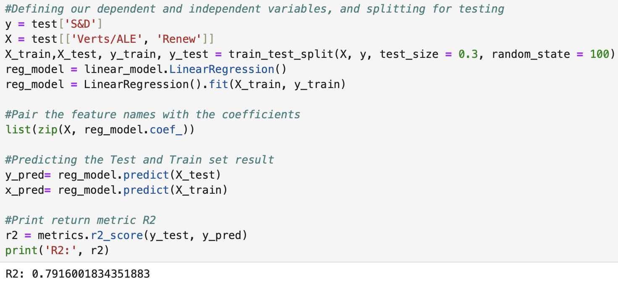
Conclusion : What about a third approach with multiple regression ?
While linear regression gives no proper results about potential correlation between the dfferent political groups, it would make no sense to conclude that no proximity can be find between all groups in the Parliament
As a result, we would need more solutions to find links between votes of more than two political groups.
Multiple regression could be a solution. For example, we tested it with S&D as dependent variable and Les Verts/ALE et Renew as independent variables. The R² of 0,79 shows a strong strong fit
11

